Slide 1
Spark Chap01

Slide 2
01
Spark简介
02
Scala语法
CONTENT
03
Spark DataFrame
04
UDF

Slide 3
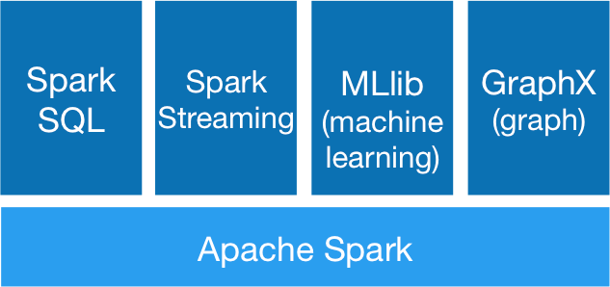
Spark组件

Slide 4
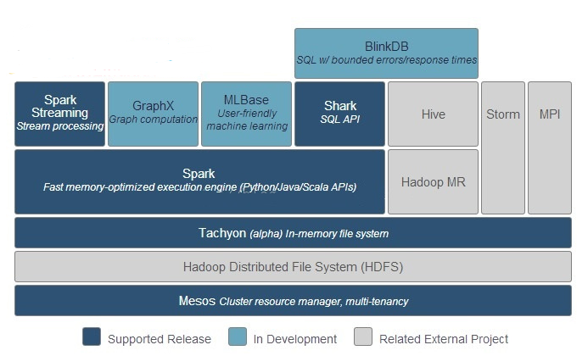
Spark生态系统

Slide 5
Scala
1. 声明值和变量
代码规范
2. 控制结构
3. 定义与调用函数

Slide 6
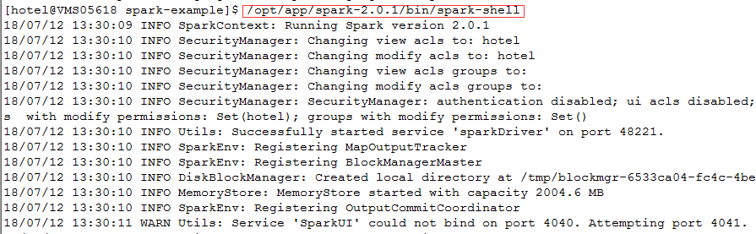
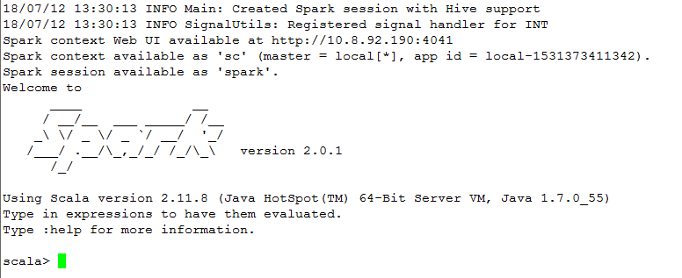
Start Spark

Slide 7
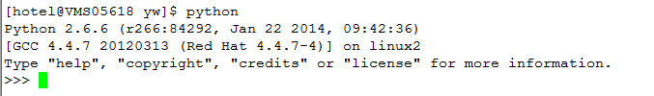
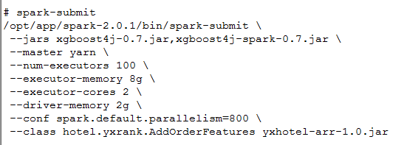
Start Spark

Slide 8
Spark DataFrame
http://spark.apache.org/docs/2.0.1/sql-programming-guide.html
https://blog.csdn.net/dabokele/article/details/52802150

Slide 9
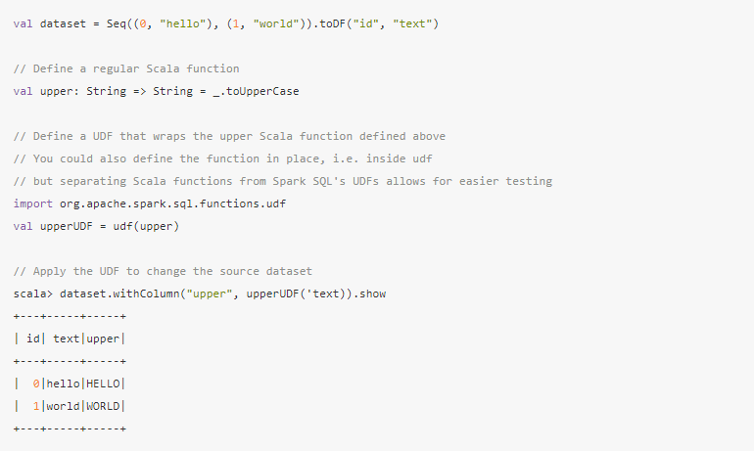
UDF
https://jaceklaskowski.gitbooks.io/mastering-spark-sql/spark-sql-udfs.html

Slide 10
THANKS FOR YOUR WATCHING

